Slide 1
Debugging
EPFL Software Engineering

Slide 2



Slide 3


???
???

Slide 4
Objectives
Develop readable code
Use a debugger to understand code
Isolate the root cause of a bug
Develop debuggable code

Slide 5
What makes code readable?

Slide 6
Exercise
Take a look at planets.py
Notes:
3min + 2min discussion

Slide 7
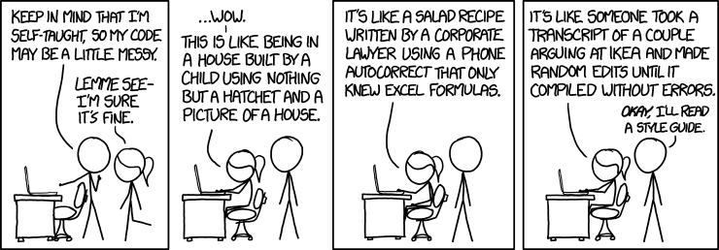
https://xkcd.com/1513/

Slide 8

In real code...
package org.scalatest.tools
object Runner {
def doRunRunRunDaDoRunRun(...): Unit
}

Slide 9
def doRunRunRunDaDoRunRun(
dispatch: DispatchReporter, suitesList: List[SuiteParam], agains: List[String], testSpecs: List[TestSpec], junitsList: List[String], stopper: Stopper, tagsToIncludeSet: Set[String], tagsToExcludeSet: Set[String], configMap: ConfigMap, concurrent: Boolean, membersOnlyList: List[String], wildcardList: List[String], testNGList: List[String], runpath: List[String], loader: ClassLoader, doneListener: RunDoneListener, runStamp: Int, concurrentConfig: ConcurrentConfig, suffixes: Option[Pattern], chosenStyleSet: Set[String], testSortingReporterTimeout: Span
): Unit
Notes:
21 parameters

Slide 10
Code readability
Naming
Documentation
Comments
Formatting
Consistency

Slide 11
 |  | Reality
 |  | True | False
Measurement | True | OK | Type I error
 | False | Type II error | OK

Slide 12
 |  | Reality
 |  | True | False
Measurement | True | OK | False positive
 | False | False negative | OK

Slide 13
Names
isUserOnline
can_overwrite_the_data
InternalFrameInternalFrameTitlePaneInternalFrameTitlePaneMaximizeButtonWindowNotFocusedState
(real class name that used to be in com.sun.java.swing.plaf.nimbus in old JDKs)

Slide 14
split("abc", "a", true, true)

Slide 15
split("abc", "a",
SplitOptions.REMOVE_EMPTY_ENTRIES,
CaseOptions.IGNORE_CASE)

Slide 16
split("abc",
separator = "a",
removeEmptyEntries = true,
ignoreCase = true)
Scala (also C#, ...)

Slide 17
“Hungarian notation”
xPosition
cmDistance
distanceTotal += speedLeft / timeLeft

Slide 18
But... “Systems Hungarian”
char cValue;
long lIndex;
unsigned uDistance;

Slide 19
F#
let distance = 30<cm>
let speed = 2<m/s>

Slide 20
Why are these poor names?
pickle (Python)
binhex (Python)
LinkedList<E> (Java, java.util)
vector<T> (C++, std::)
SortedList (C#, System.Collections)
Notes:
5min; pickle = weird way to say (de)serialize; binhex = not bin/hex but old Mac OS format; LinkedList is doubly linked; vector is a resizeable array not math; SortedList is a map

Slide 21
Names as a tool
Clarity
Succinctness
Consistency with language, framework, ...

Slide 22
Documentation
/**
* Writes the specified string value, ...
*/
…

Slide 23
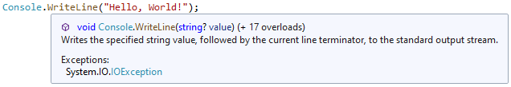

Slide 24
Comments
“Why?”

Slide 25
Not “how?”
// increment i
i = i + 1;
// add item to list
list.add(item);

Slide 26
Why comment?
Bug workarounds
Unexpected requirements
Performance tricks
...

Slide 27
/* Workaround: 32bit app on 64bit linux gets assertion failure trying to open ports. Until the issue is fixed in ALSA (bug 4807) report no midi in devices in the configuration. */
if (jre32onlinux64) { return 0; }
From old JDK “libjsound” on Linux

Slide 28
Comments are for…
Code reviewers
Colleagues
Future you!

Slide 29
Formatting
Why format ?
To make code readab-le Otherwise, bugs are are harder to find
Notes:
(this slide looks broken, that’s the point)

Slide 30
Apple vulnerability
if (!update(&context, &params))
goto fail;
goto fail;

Slide 31
if (!update(&context, &params)) {
goto fail;
}
goto fail;

Slide 32
File "script.py", line 3 x = 42 ^ IndentationError: unexpected indent
Python (also: F#, Make, ...)

Slide 33
Choices
camelCase? snake_case?
4 spaces? 8? Tabs?
...

Slide 34
Conventions
Decide once
Benefit from consistency without thinking

Slide 35







Beware of “bikeshedding”

Slide 36
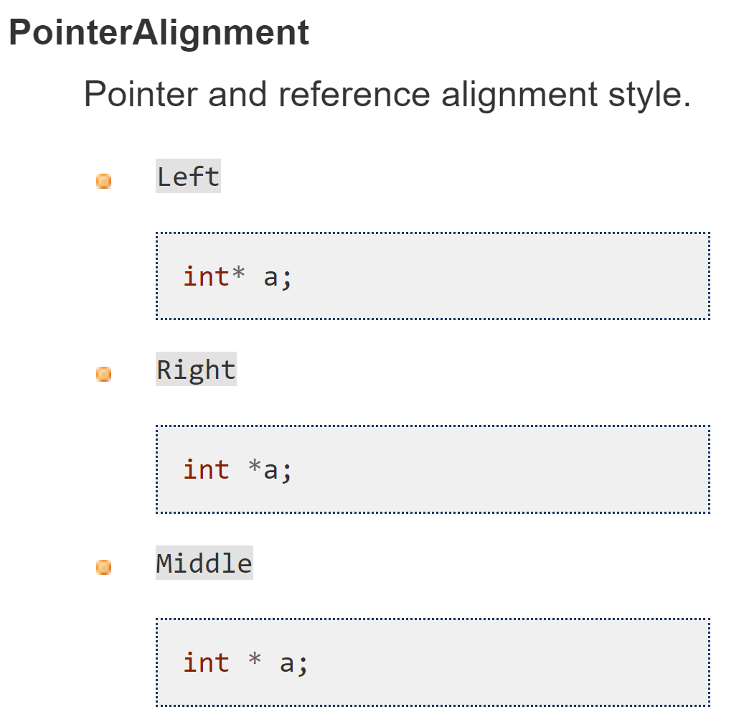
Tooling
clang-format

Slide 37
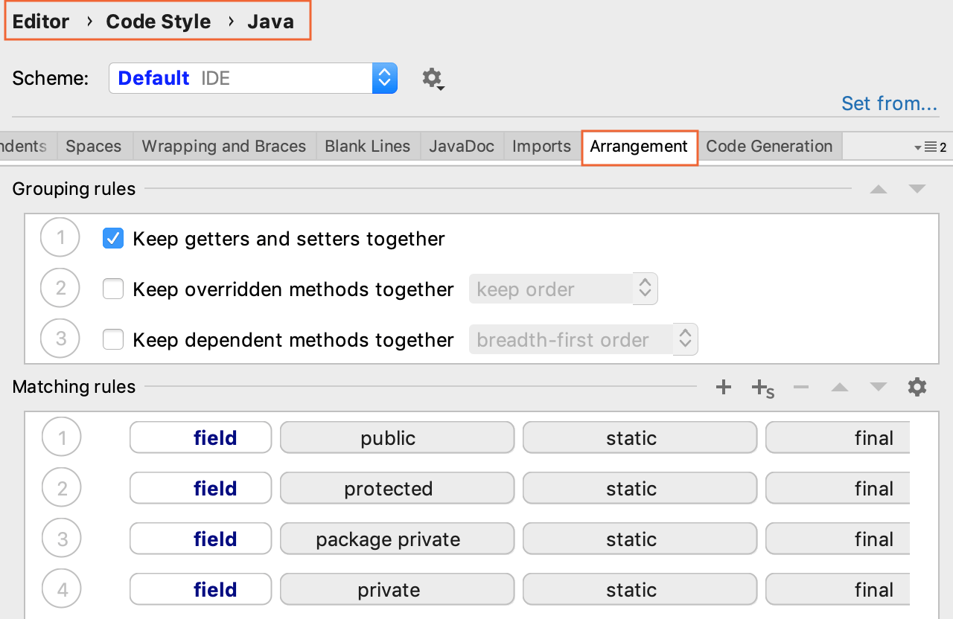
IntelliJ

Slide 38
How can one efficiently debug a program?

Slide 39
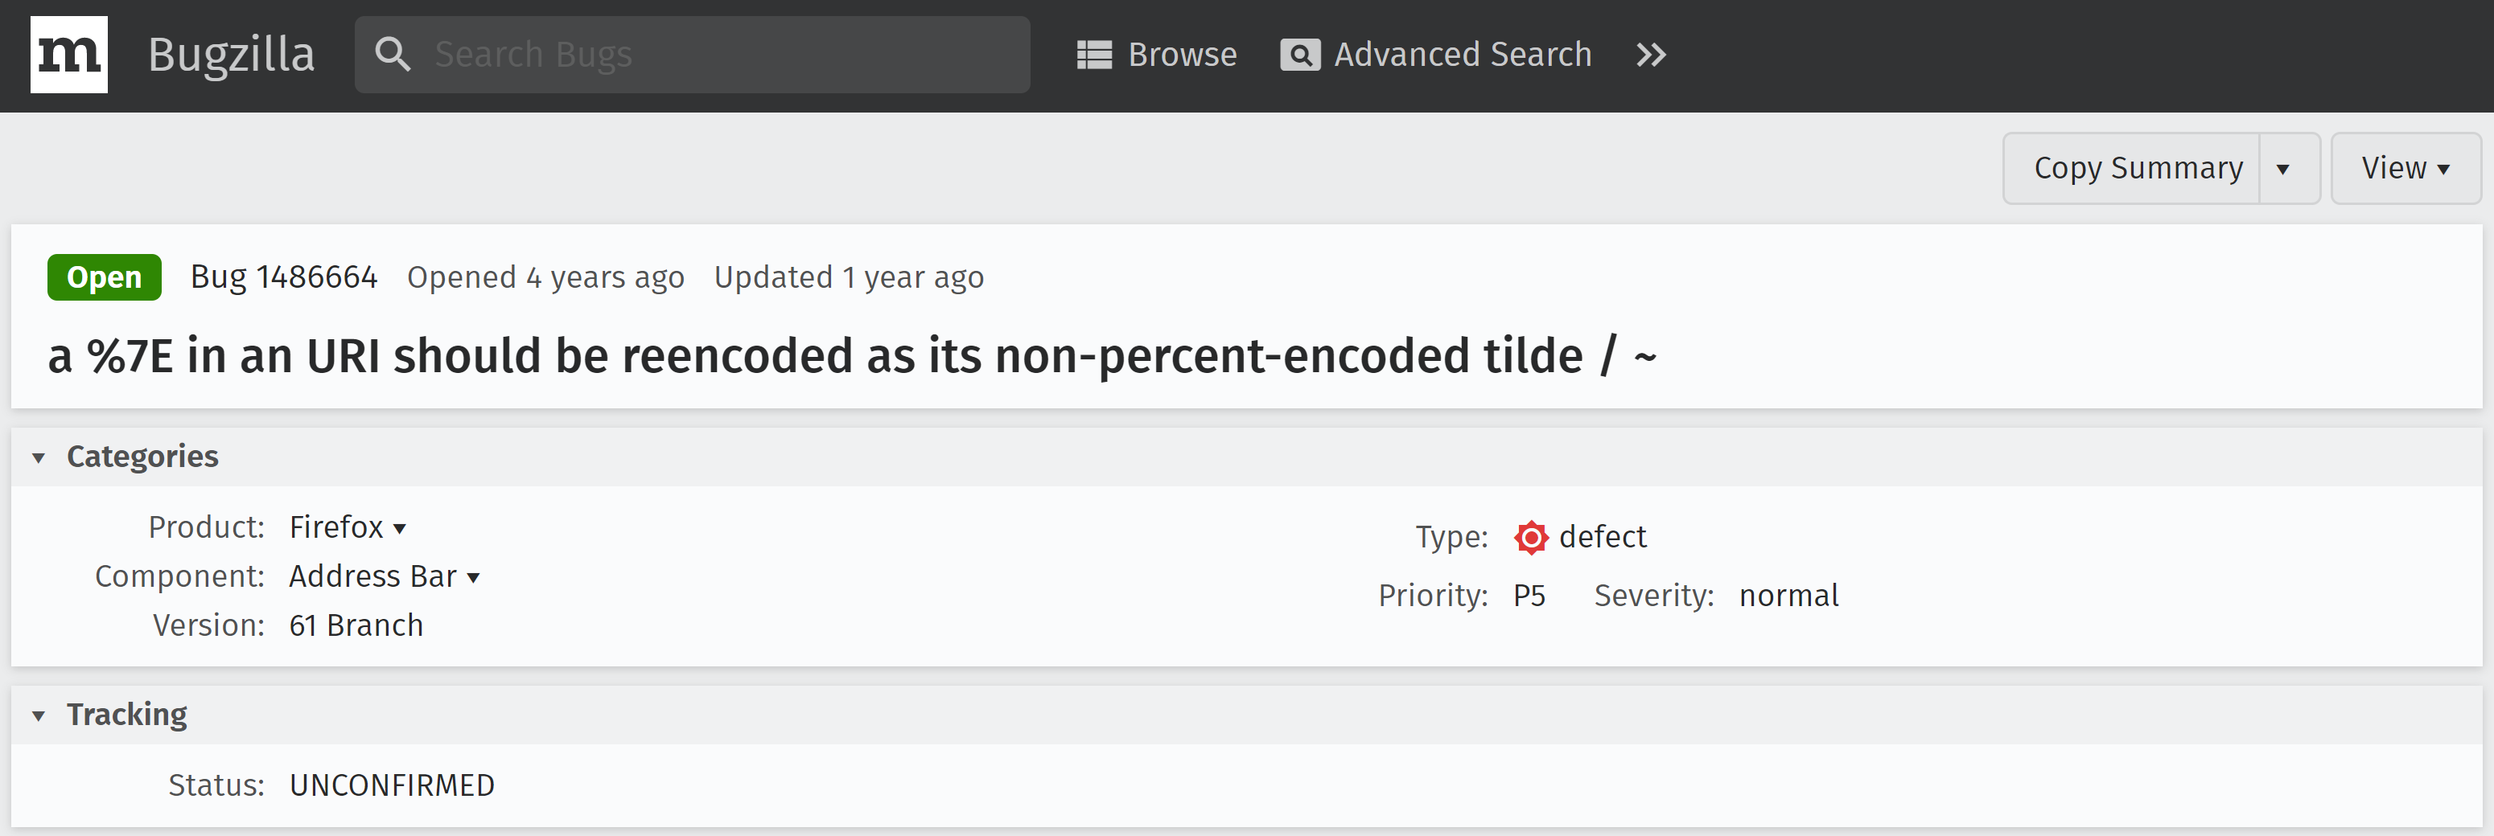
https://bugzilla.mozilla.org/show_bug.cgi?id=1486664

Slide 40


≠

Slide 41
Debugging goal
Find and fix the root cause

Slide 42
Root cause: why?
I was late to class
I woke up late
My alarm didn’t ring
My phone had no battery
I forgot to plug my phone before going to sleep

Slide 43
Debugging steps
Reproduce the bug
Isolate the root cause
Debug

Slide 44
Reproducing
Environment?
Steps?
Expected outcome?
Actual outcome?
Automated test?

Slide 45


Isolating

Slide 46
Debug: prints?
printf(
"size: %u, capacity: %u\n",
size,
capacity
);

Slide 47
Print disadvantages?
Slow to write
Need code changes
Need to recompile

Slide 48
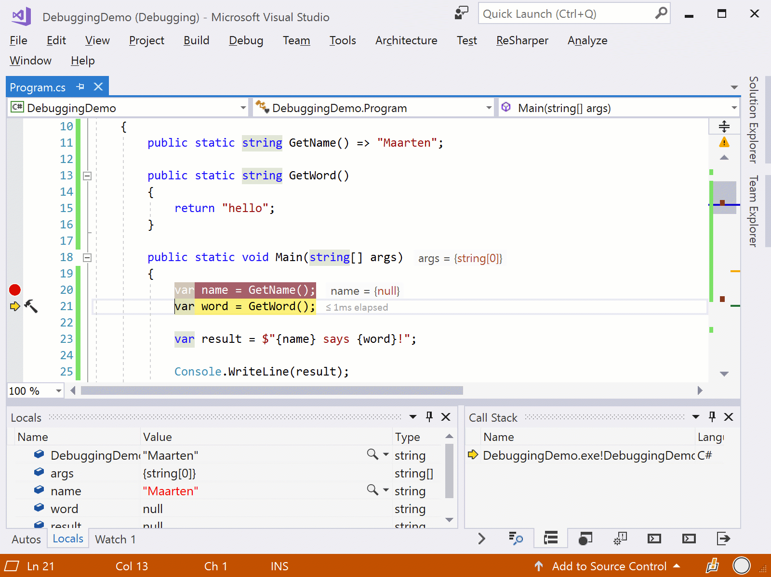
Debugger
https://blog.jetbrains.com/dotnet/2017/11/21/resharper-2017-3-brings-debugger-editor/

Slide 49






≠

Slide 50







n00b

Slide 51

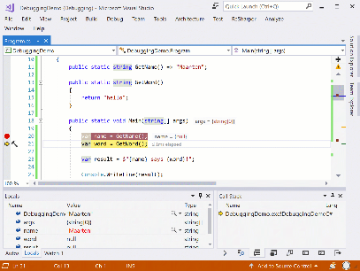
n00b

Slide 52
?!?!?

Slide 53
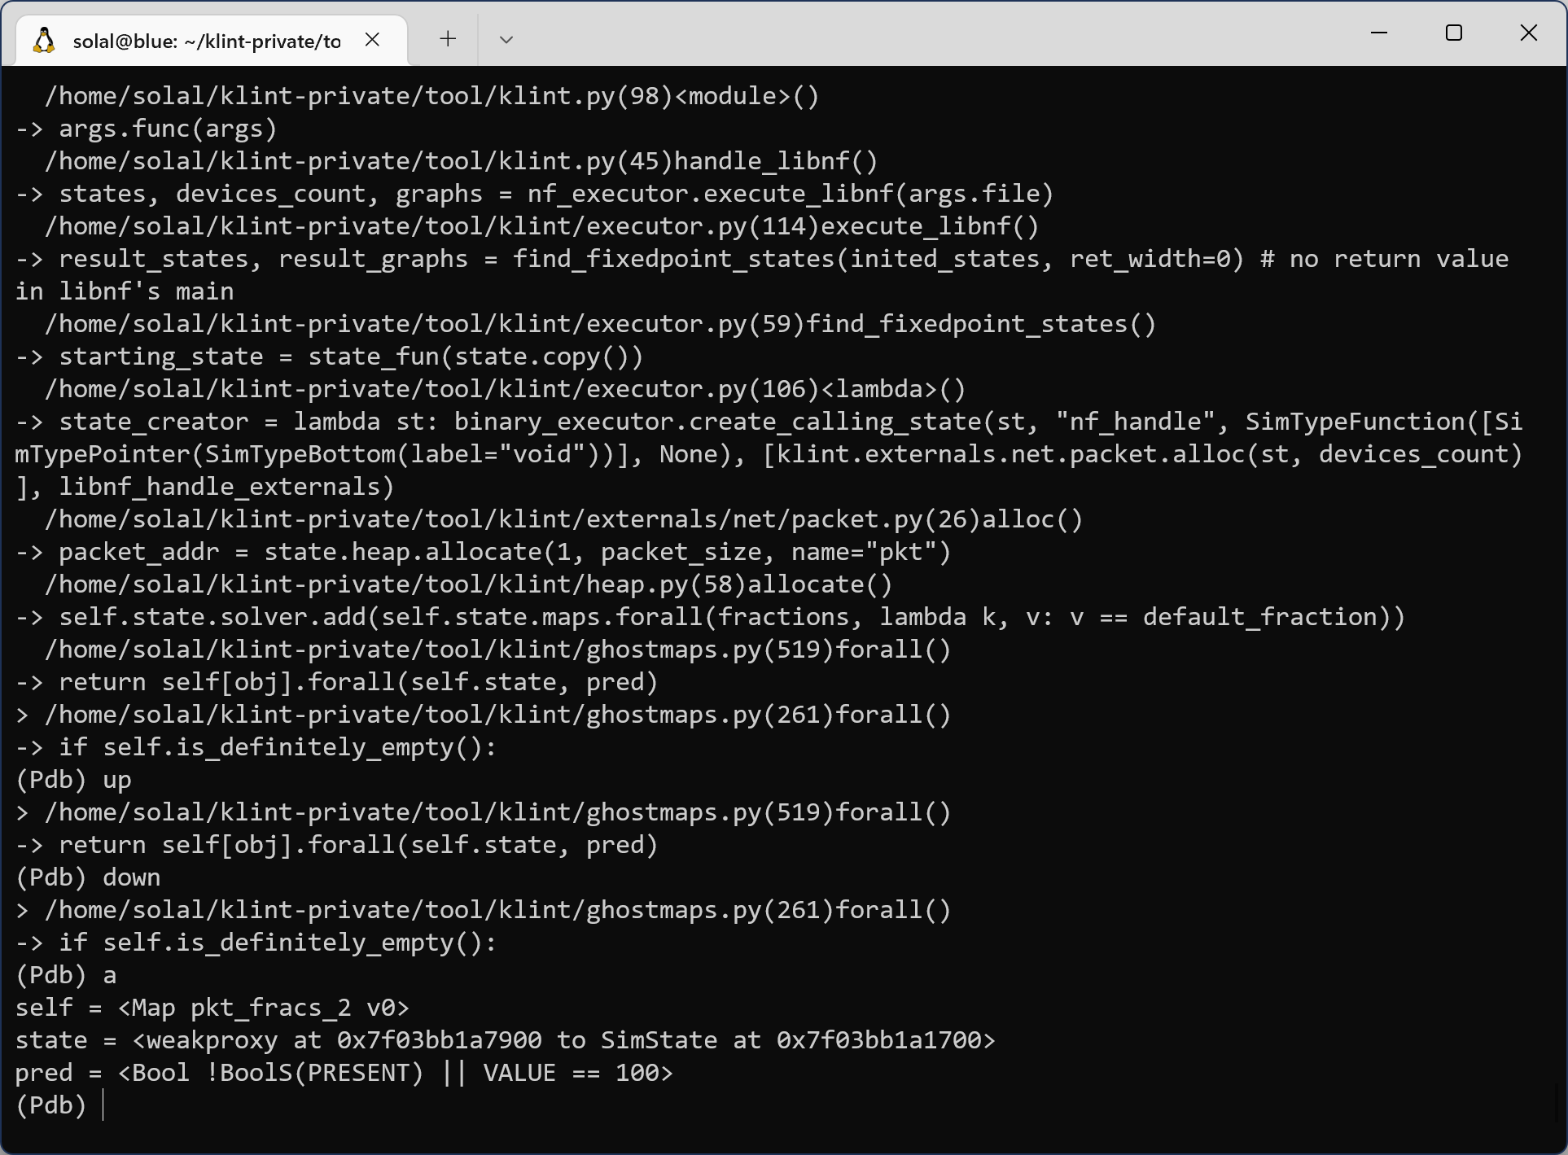
CLI

Slide 54
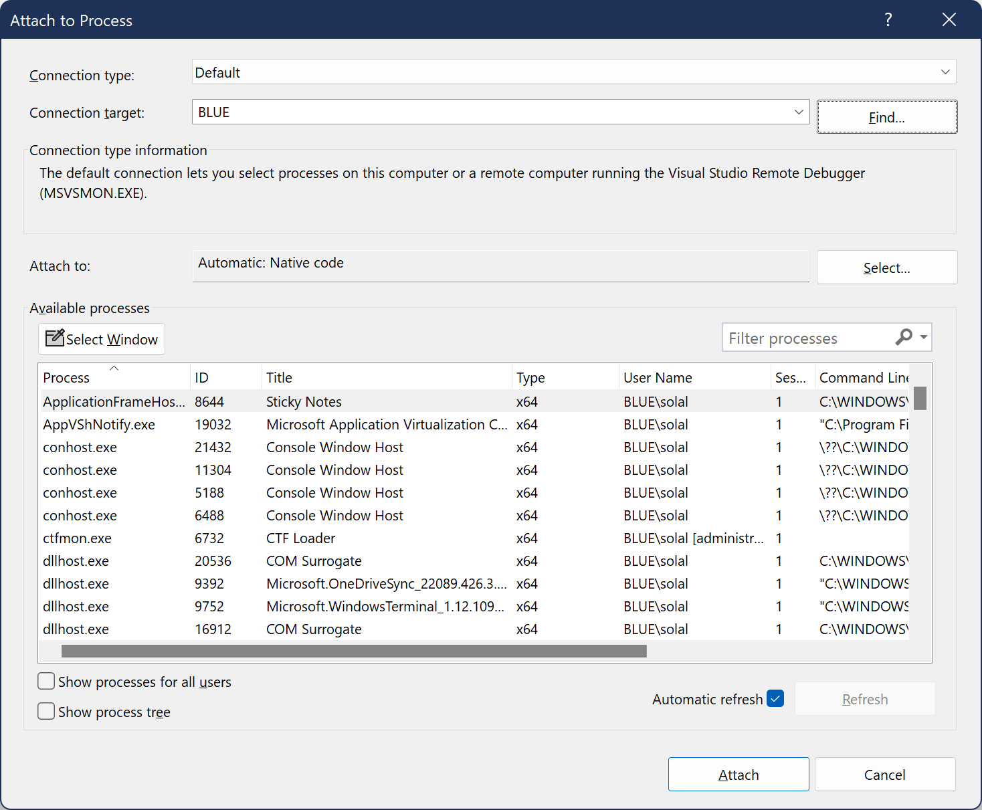
Remotely

Slide 55
Prerequisite: Debug symbols

Slide 56
Key tools
Pause execution
Inspect state
Edit state
Inspect the call stack
Step-by-step execution

Slide 57
“Does the program reach this line?”

Slide 58
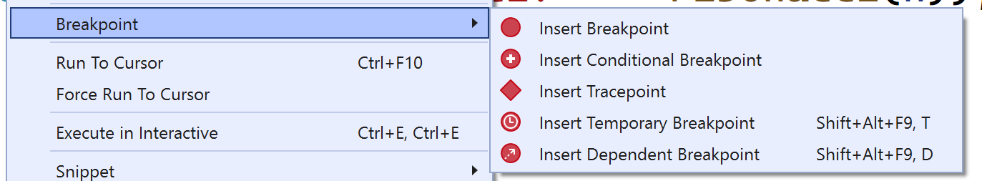

Slide 59
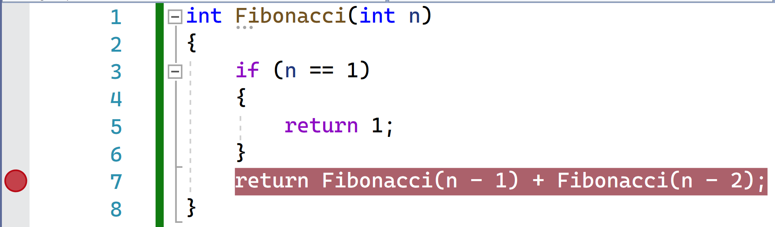

Slide 60
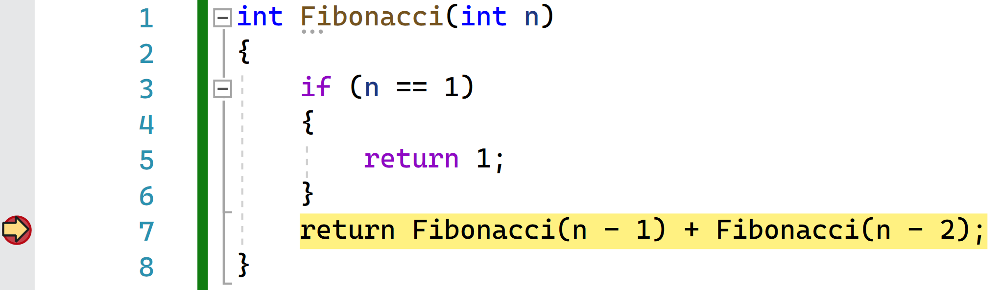

Slide 61
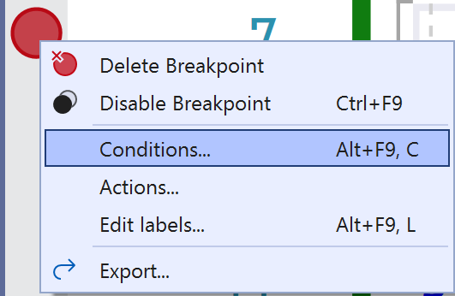
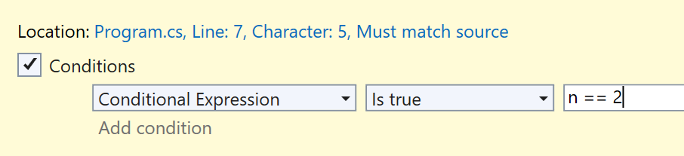
Conditional breakpoint

Slide 62
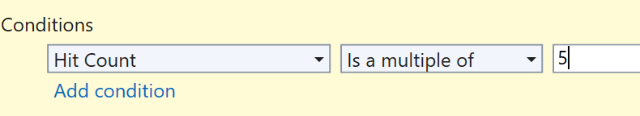
“Once every N times”

Slide 63
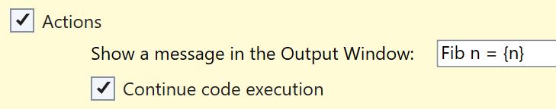
Prints!

Slide 64
Breakpoint vs print(...)
No code changes
Edit while running

Slide 65
“What is the value of this variable?”

Slide 66

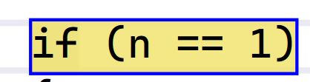
n | 11

Slide 67
s | <Stack>
_size | 2
_items | <Array, length 3>
[0] | "A"
[1] | "B"
[2] | ""

Slide 68
Executing code
> n % 12 == 0
false
> IsPrime(n)
true

Slide 69
“What if instead...?”

Slide 70
> n = 10
> lst.add("x")

Slide 71
“What will happen next?”

Slide 72
Step Over
void Shuffle(int[] a)
{
...
}
vals = GetValues();
Shuffle(vals);
return vals[0];

Slide 73
Step Into
void Shuffle(int[] a)
{
...
}
vals = GetValues();
Shuffle(vals);
return vals[0];

Slide 74
Step Out
void Shuffle(int[] a)
{
...
}
vals = GetValues();
Shuffle(vals);
return vals[0];

Slide 75
Run until...
void Shuffle(int[] a)
{
...
}
vals = GetValues();
Shuffle(vals);
return vals[0];

Slide 76
And more!
Force return
Change instruction pointer
Edit and Continue
...

Slide 77
Keyboard shortcuts
F5, F9, F10, F11, ...

Slide 78
“How did we get here?”

Slide 79
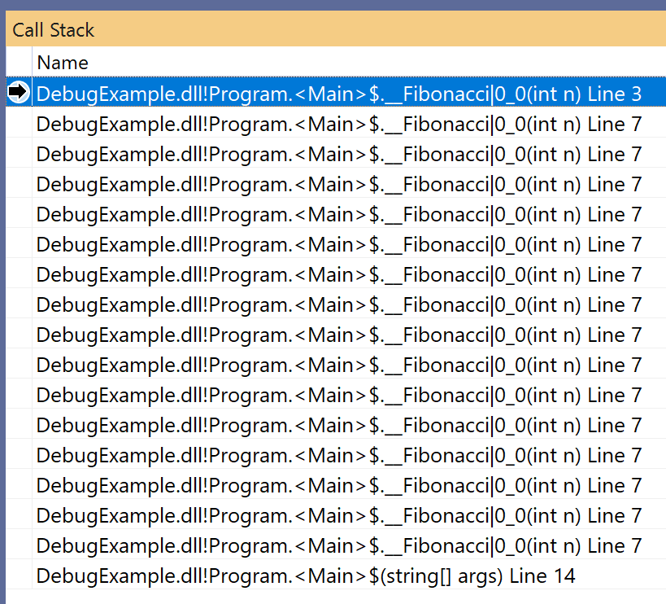
Call stack

Slide 80
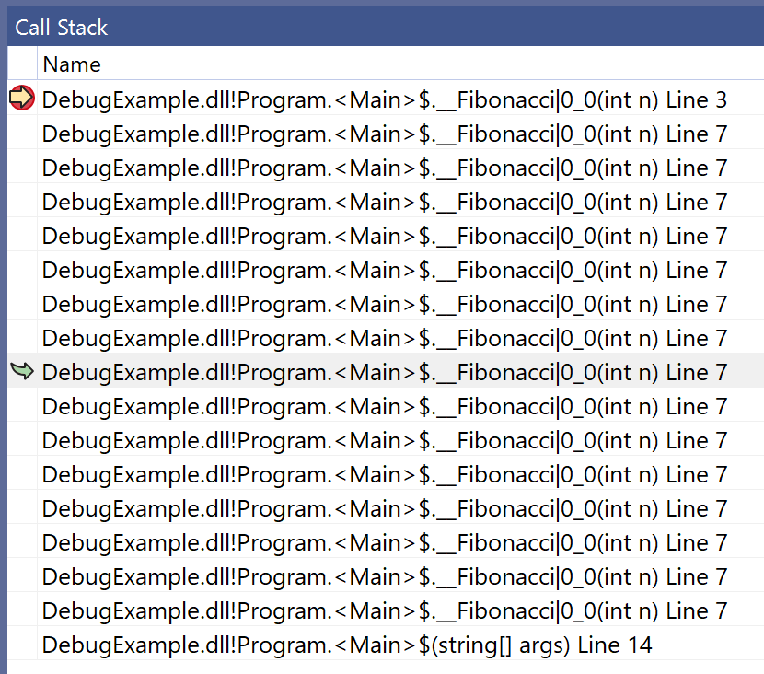

Slide 81
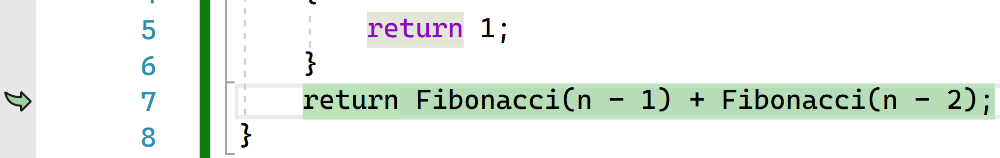
Previous state

Slide 82
“What happened to cause a crash?”

Slide 83
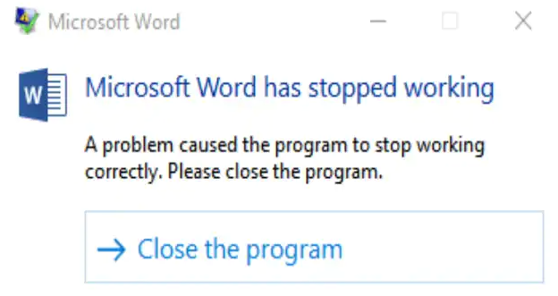

Crash dumps

Slide 84
In practice
Breakpoint
Inspect
Edit
Repeat

Slide 85
Asking for help
Bug symptoms?
Minimal example?
What did you try?

Slide 86

“Rubber ducking”

Slide 87
Exercise
Find and fix the bugs in binary-tree/
First step: Run the code, add breakpoints, inspect
Notes:
15min

Slide 88
Solution: Add base case
if (list.size() == 0) { return null; }

Slide 89
Solution: Fix bounds
return new BinaryTree(
list.get(mid),
fromList(list.subList(0, mid)),
fromList(list.subList(mid+1, list.size()))
);

Slide 90
Solution: Fix the constructor
BinaryTree(...) {
right = r;
}

Slide 91
Debug, debug, debug
Get used to it!

Slide 92
What makes code debuggable?

Slide 93
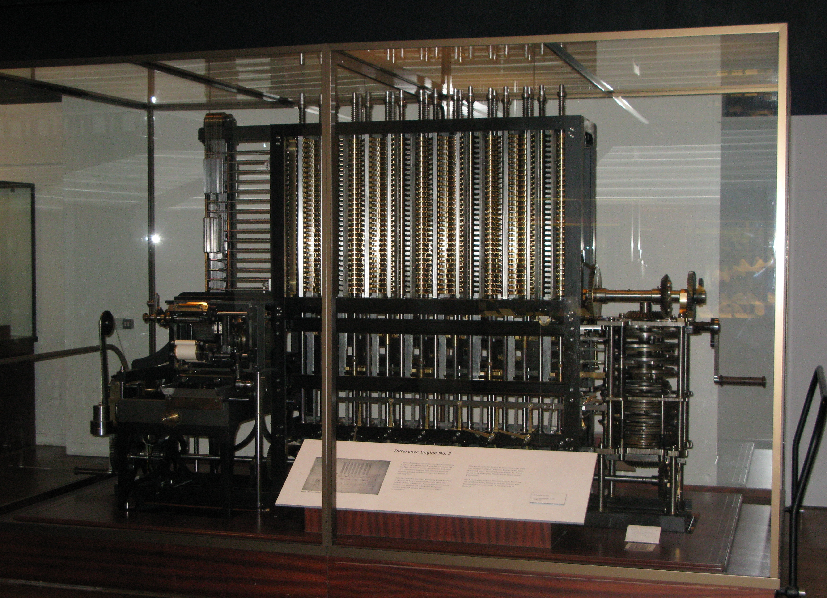
Charles Babbage’s Difference Engine (Wikipedia)

Slide 94
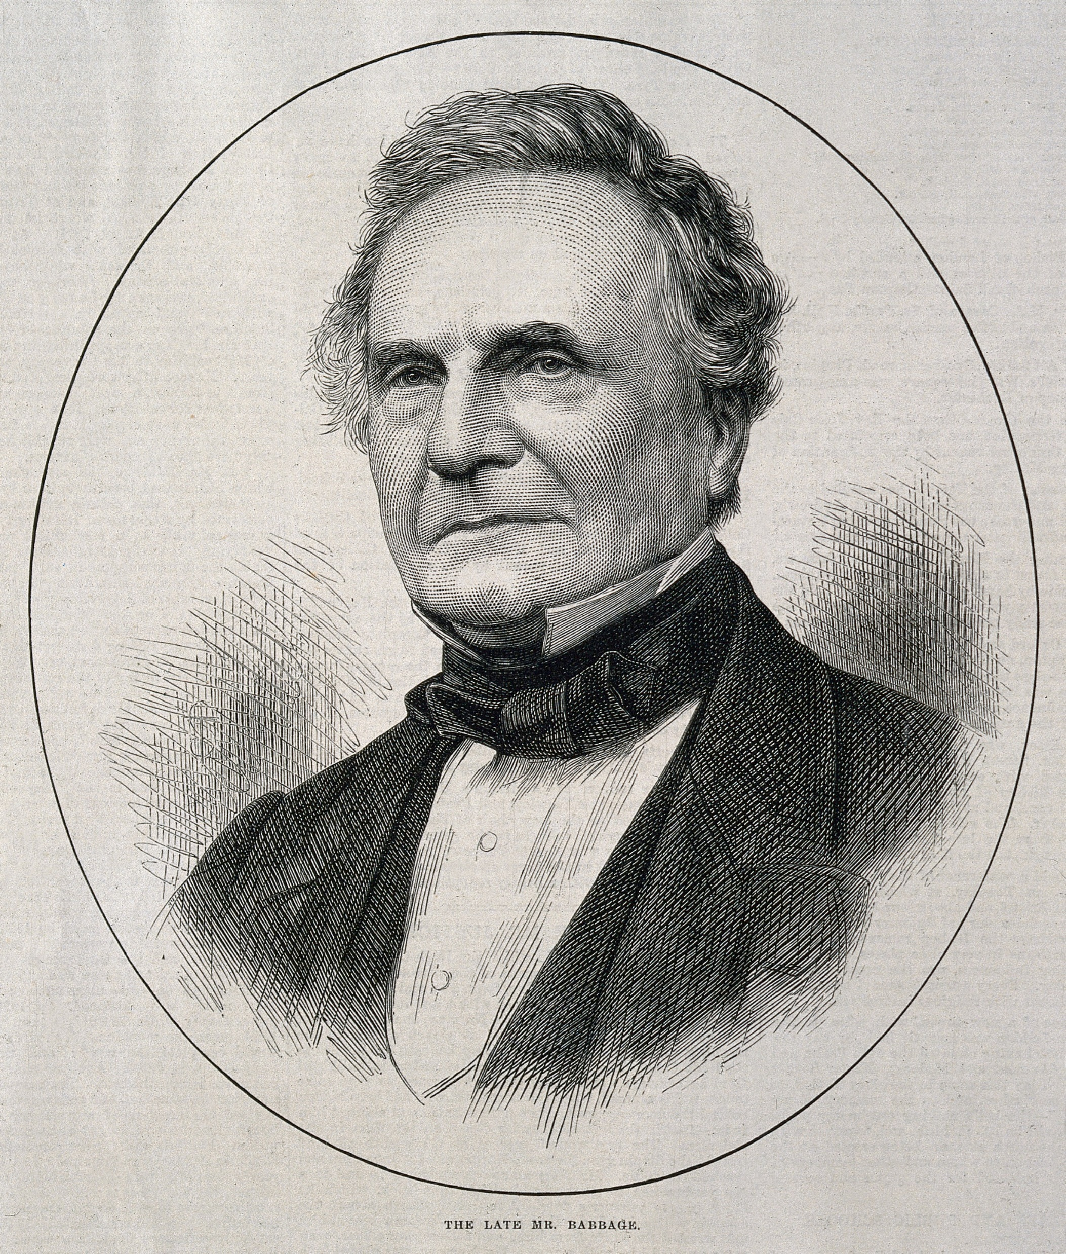
“On two occasions, I have been asked 'Pray, Mr. Babbage, if you put into the machine wrong figures, will the right answers come out?' …
Passages from the Life of a Philosopher (image: wood engraving from 1871, Wikipedia)

Slide 95
… I am not able to rightly apprehend the kind of confusion of ideas that could provoke such a question.”
Charles Babbage

Slide 96
Problem
“Garbage in, garbage out”

Slide 97

Where’s the root cause?

Slide 98

“We learned to spend more time up front […] so we wouldn’t waste all that time debugging”
Margaret Hamilton
The Language as a Software Engineer, ICSE 2018 keynote (photo: still from a MAKERS interview)

Slide 99
Code debuggability
Defensive programming
Logging
Debug-only code

Slide 100



“Defensive” programming

Slide 101




This is fine.

Slide 102
Defend against…
Bugs
Humans
Attackers
Corruption
…

Slide 103
Corruption?
microsoft.com
→
microsmft.com
http://dinaburg.org/bitsquatting.html

Slide 104

Defensive programming
Garbage in, error out

Slide 105
Assertions
int val = ...;
int[] array = ...;
// Find the index of `val` in `array`
int index = ...;
// ...

Slide 106
if (array[index] != val) {
throw new AssertionError(...);
}

Slide 107

What to do with errors?
Abandon the request, module, …

Slide 108
Preconditions
/** `array` must not be null or empty */
int pickOne(int[] array) { ... }

Slide 109
if (array == null || array.length == 0) {
throw new IllegalArgumentException(...);
}

Slide 110
Exception types
“Whose fault is it?”

Slide 111
Postconditions
/** Returns a value in `array` */
int pickOne(int[] array) { ... }

Slide 112
result = ...
if (!contains(array, result)) {
throw new AssertionError(...);
}
return result;

Slide 113
Object invariants
class Stack {
// Invariant: -1 <= top < values.length
private int[] values;
private int top;
}

Slide 114
Invariants
= Precondition + Postcondition

Slide 115
// Don't forget to call // at construction + // begin and end of each method
void assertInvariants() { ... }

Slide 116

Protecting state
void setWords(List<String> words) {
this.words = words;
}
setWords(badWords);
badWords.add("Bad!");

Slide 117
void setWords(List<String> words) {
this.words = new ArrayList<>(words);
}

Slide 118
List<String> getWords() {
return this.words;
}
var badWords = getWords();
badWords.add("Bad!");

Slide 119
List<String> getWords() {
return new ArrayList<>(this.words);
}

Slide 120
Only copy mutable data
words:
scala.collection.immutable.List[String]

Slide 121
Exercise
Add code to catch problems early to stack/
Fix any bugs
First step: what should the constructor check?
Notes:
2min til next

Slide 122
Constructor: Precondition
if (maxSize < 0) { throw ... }
Notes:
Now add an invariant and use it; 5min til next

Slide 123
Invariant
-1 <= top && top < values.length
Notes:
Now add a precondition for push, how will callers check it? 4min til next

Slide 124
Exposing full-ness
boolean isFull() { ... }
// then use for push precondition
Notes:
Now try to fix the bugs! 4min

Slide 125
Bug: pop breaks the invariant
top--;

Slide 126
Bug: push increments too late
top++;
values[top] = value;

Slide 127
Logging
“What happened in production?”

Slide 128
Logging?
print("Request: " + request)
print("State: " + state)

Slide 129
Precision?
Each...
function?
request?
minute?
...

Slide 130
Target?
Console?
File?
Both?
Email?
...

Slide 131
logging.debug("Detail")
logging.info("Information")
logging.warning("Warning")
logging.error("Error")
logging.critical("What a Terrible Failure")

Slide 132
Logging
Various levels, sinks, ...
Pick at runtime

Slide 133
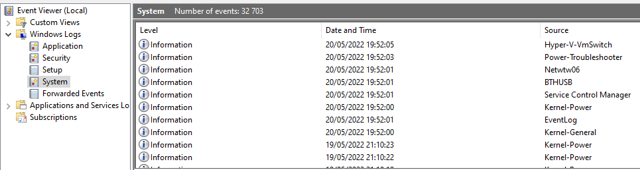

Slide 134
Think about privacy!
logger.info("password = " + password)
logger.info("request = " + request)

Slide 135
What about slow checks?
// Invariant: each node has <=2 edges

Slide 136
Debug-only code
if __debug__:
# slow stuff
# overly detailed logs
# ...

Slide 137
Check your defaults
Python: on, unless -O
Java: off, unless -ea
Scala: on, unless -Xelide-below=...
...

Slide 138
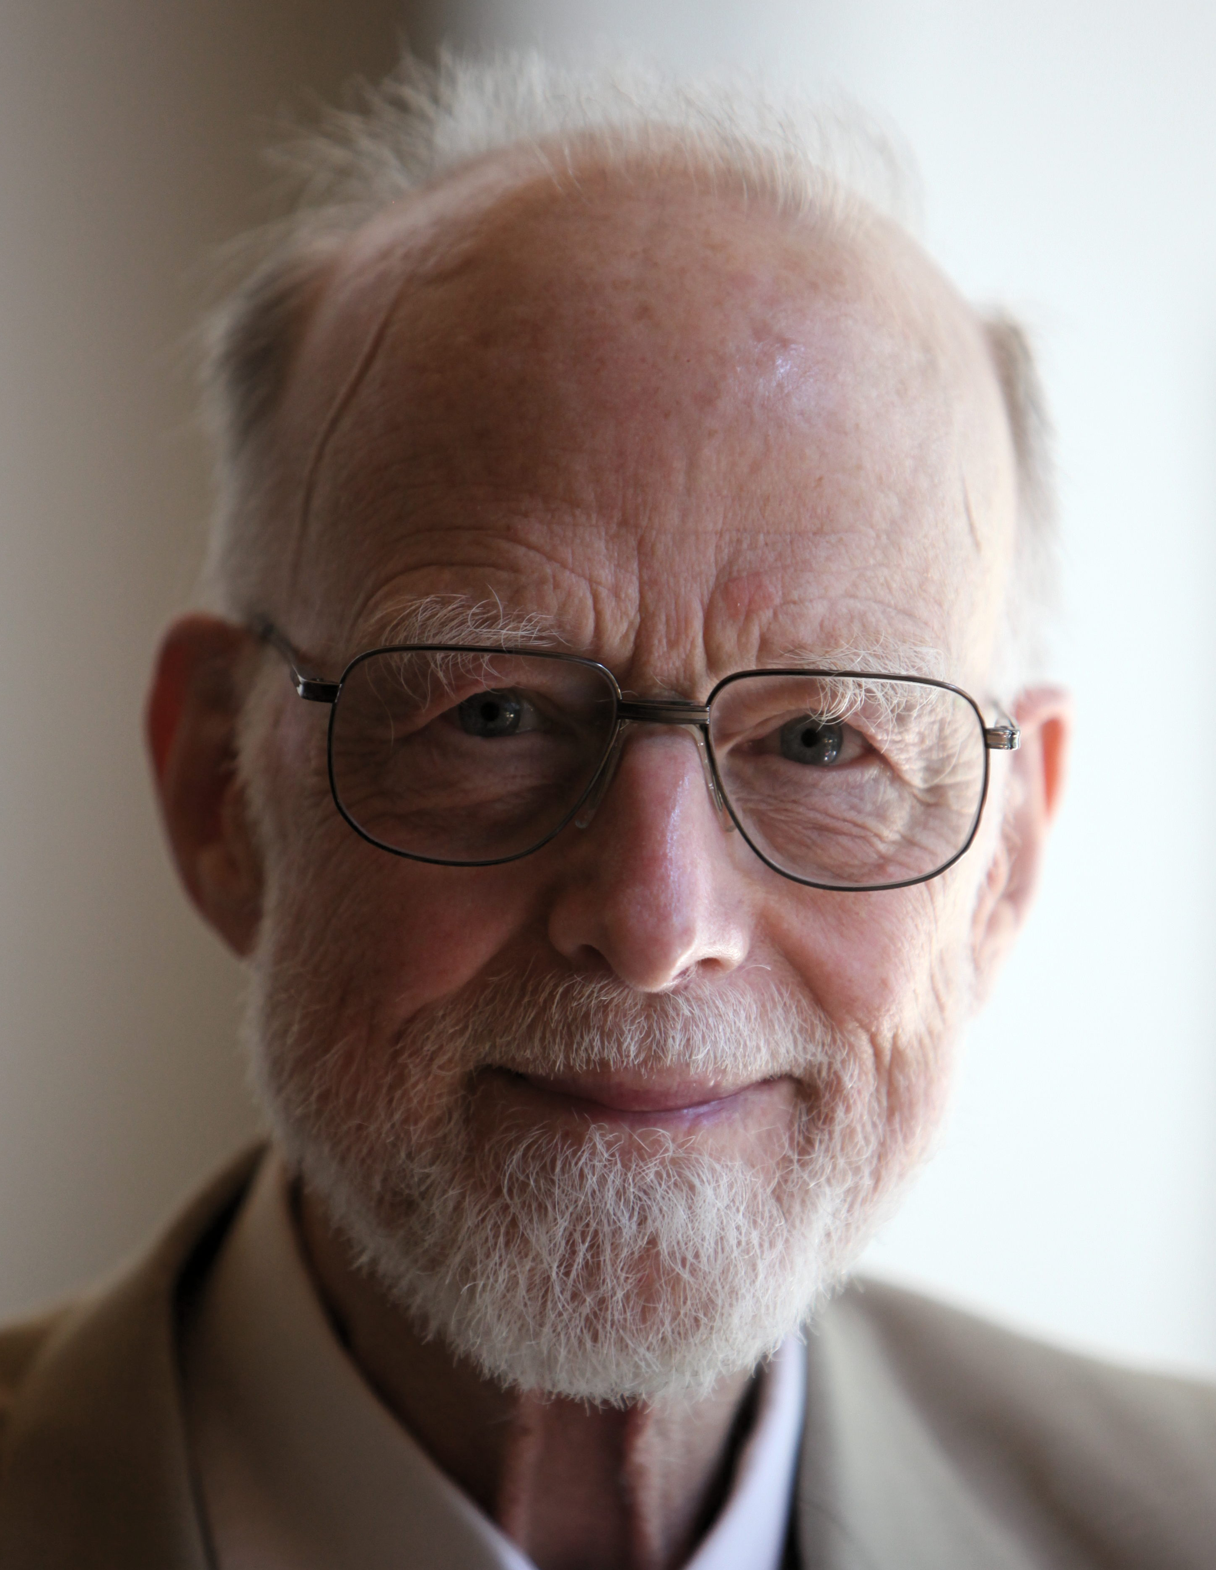
“It is absurd to make elaborate security checks on debugging runs, when no trust is put in the results, and then remove them in production runs, when an erroneous result could be expensive or disastrous.
…
Hints on Programming Language Design (photo: Rama, Wikipedia)

Slide 139
… What would we think of a sailing enthusiast who wears his life-jacket when training on dry land but takes it off as soon as he goes to sea?”
Tony Hoare

Slide 140
Summary
Readable code: Naming, formatting, comments, conventions
Debugging: Reproducing bugs, using a debugger
Debuggable code: Defensive programming, logging

